Slide 1

Vacation pay software
ManaTime
Starting well (Manager)

Slide 2




Recommended browsers
Google Chrome
Firefox
Safari

Slide 3




Disadvised browsers
Microsoft Edge
Opéra
Internet Explorer

Slide 4
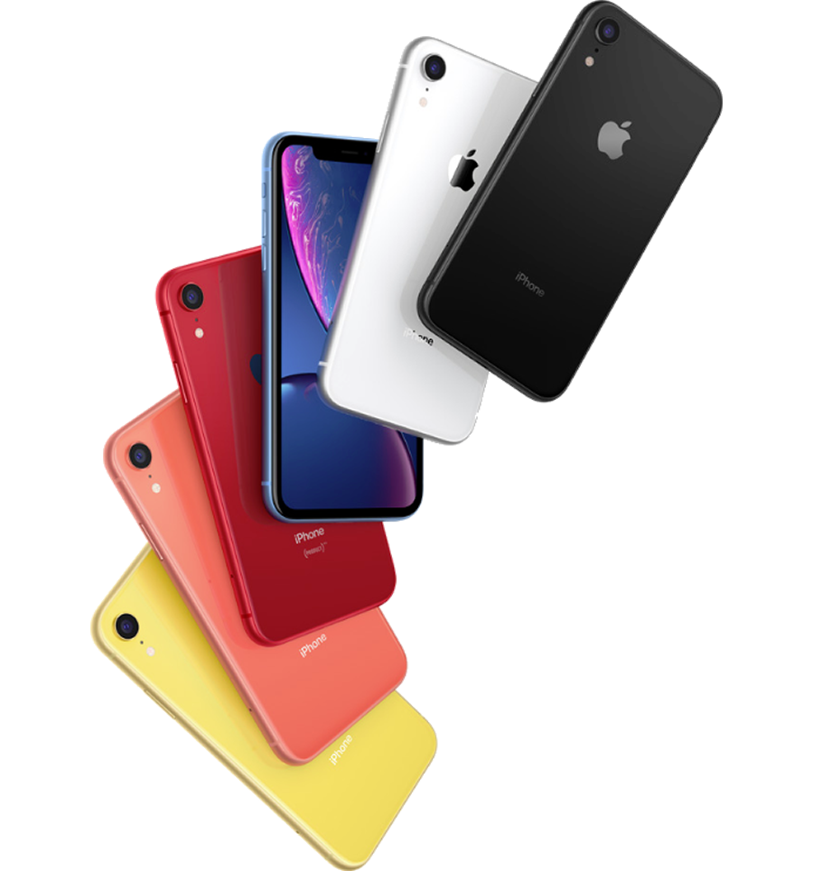

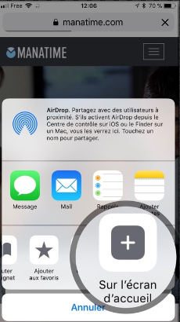

Install it on your iPhone / iPad

Slide 5
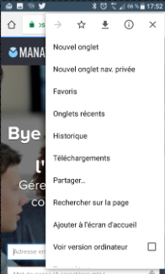

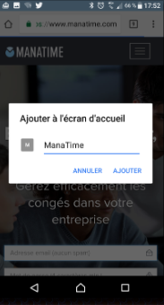

Install it on your Android / Tablet

Slide 6



Available on all devices !

Slide 7
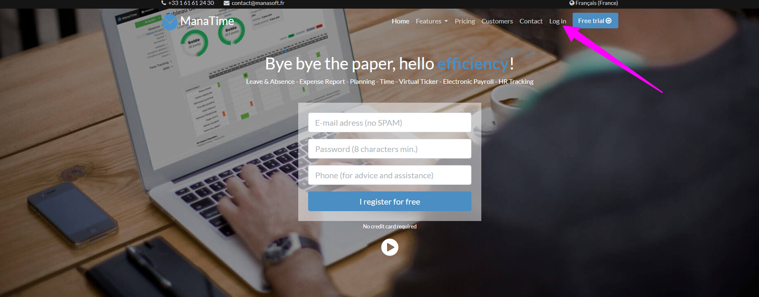
Login to our website http://www.manatime.com/

Slide 8

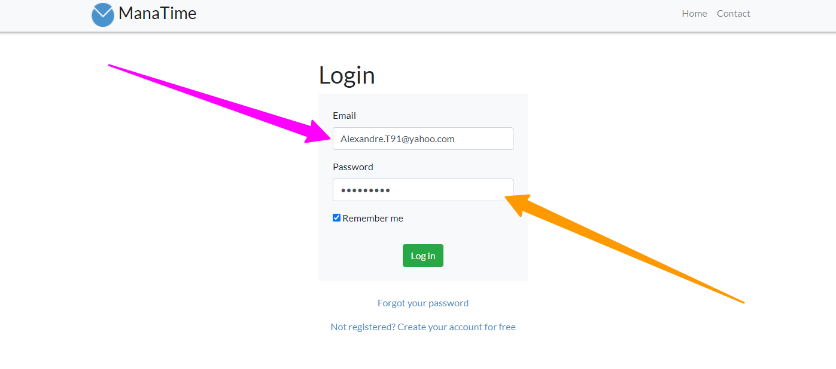
Enter your Ids

Slide 9

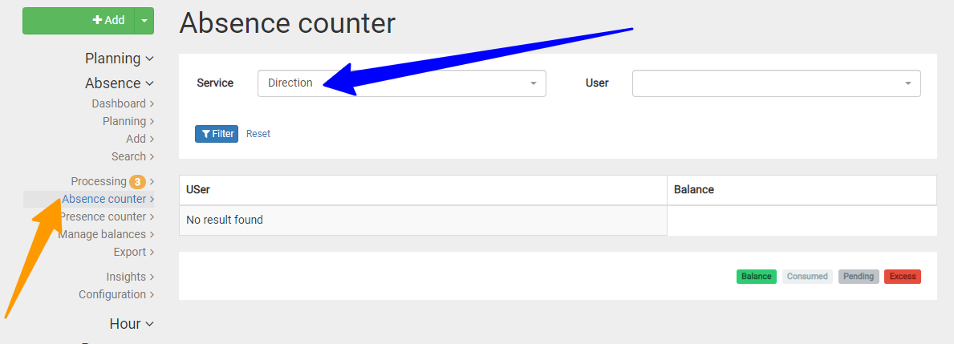
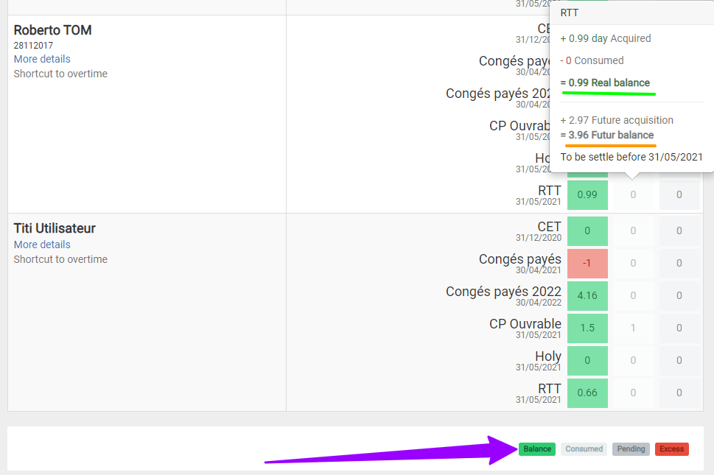
Consult the balance of his team
Click on absence and then " Absence counter ".
Choose the desired service.
You have the actual and future balance of your entire team.
A small legend at the bottom right is present if needed.

Slide 10

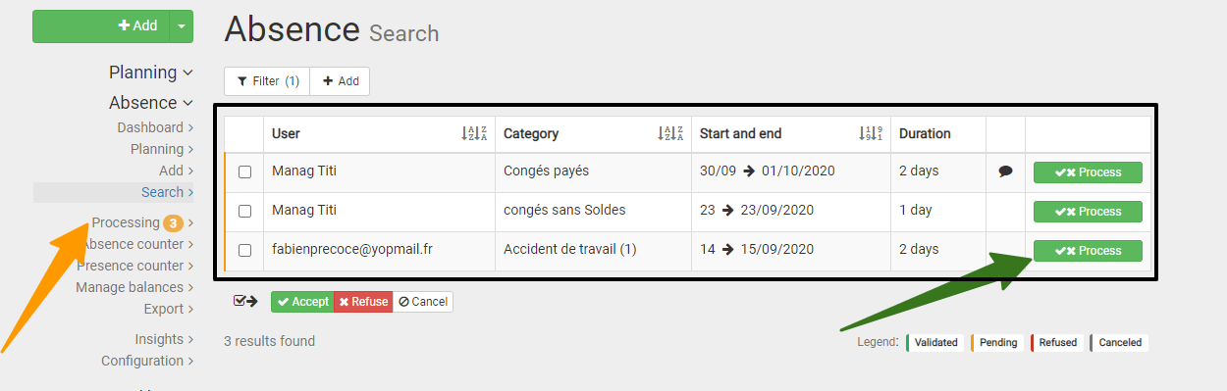
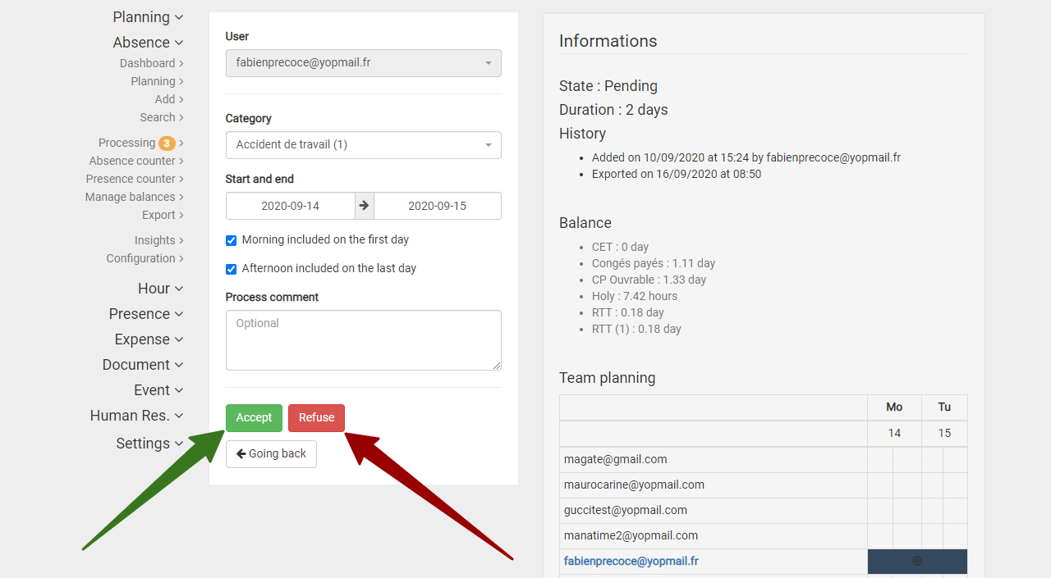
Validate / Refuse an absence request
Click on Absence then Processing.
A list appears click on "process".
Accept or refuse this request.
An email will be automatically sent to the
user or the N+2 depending on your configuration.

Slide 11

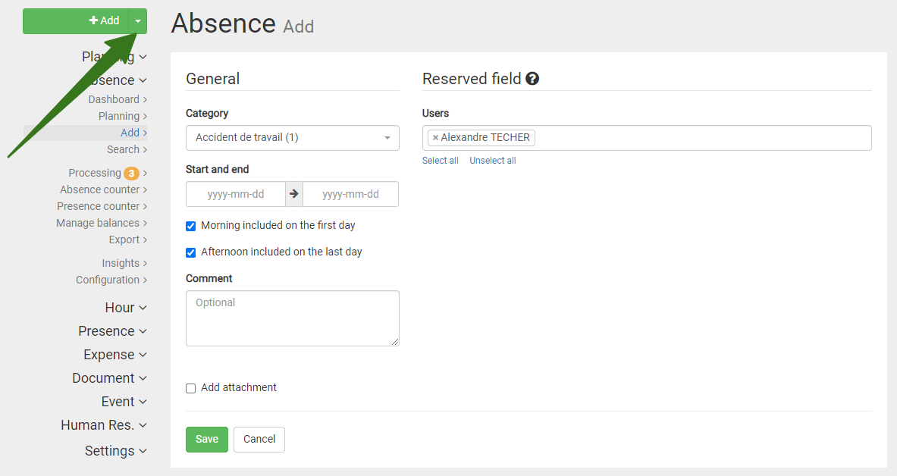
Filing an absence for an employee
Click on the button
Fill in the boxes now
Your name is automatically selected, you can, as a manager, file an absence for one of your employees.

Slide 12

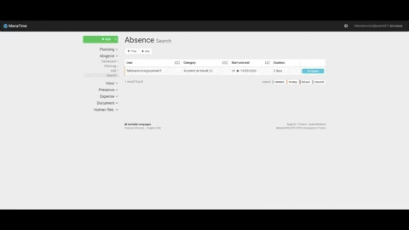
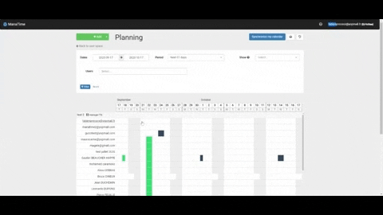
Another method in GIF !

Slide 13

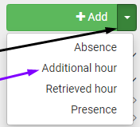
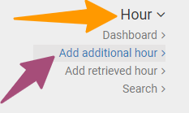
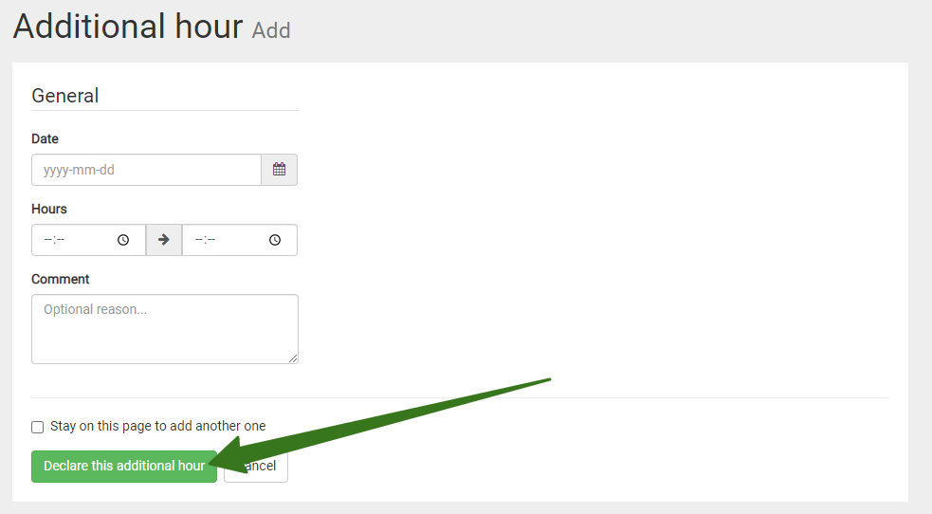
Deposit an extra hour / Recovery
Click on the arrow to the right of the "Add" button and choose overtime or recovery time.
You can also click Time / Add additional hour / Retrieved in your menu bar.
Then complete your form, register your request, it will be validated by your manager.

Slide 14

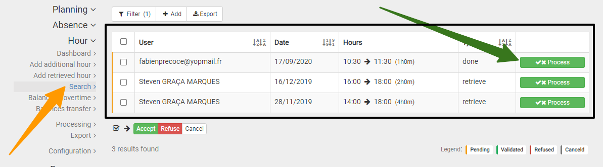
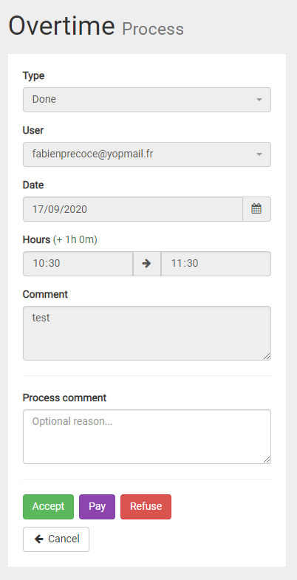
Validate an extra hour / recovery time
Click on Time then Processing.
A list appears, click on process.
Accept, pay, refuse this request.
An email will be automatically sent to the user.

Slide 15

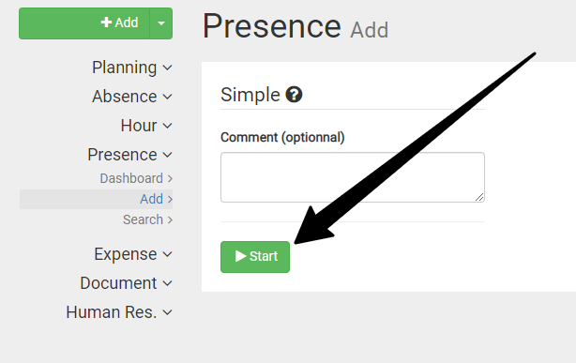

Start & Stop (Virtual Pointer)
Go to the tab "Presence" / "Add".
Comment (if necessary) and click Start.
Or click on the one on the top left.

Slide 16

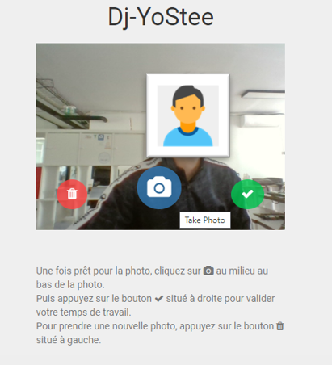



Face Tracking (1/2)
Place yourself in front of your photo space (sent link, tablet, PC, etc...)
Take a picture of yourself
Delete
Validate

Slide 17



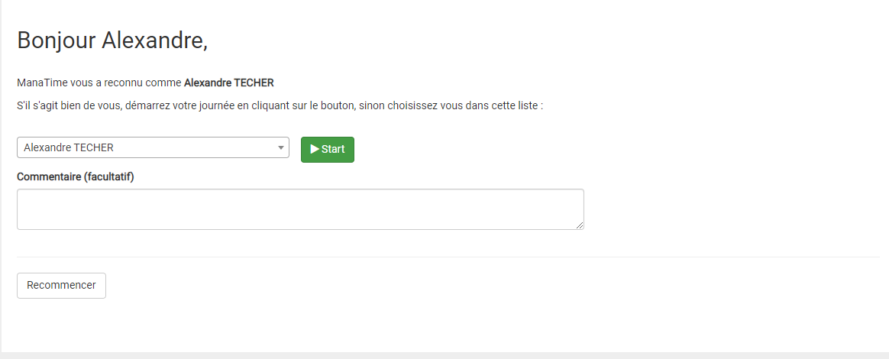
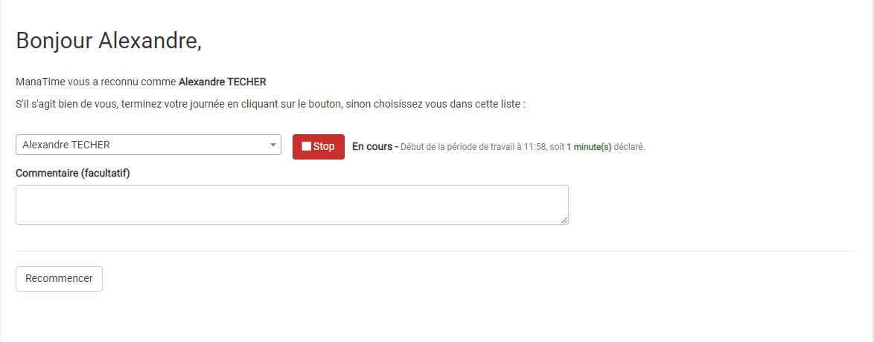
Continuation of the Process (2/2)
This is the end! Take a picture of yourself and
Click on

Slide 18
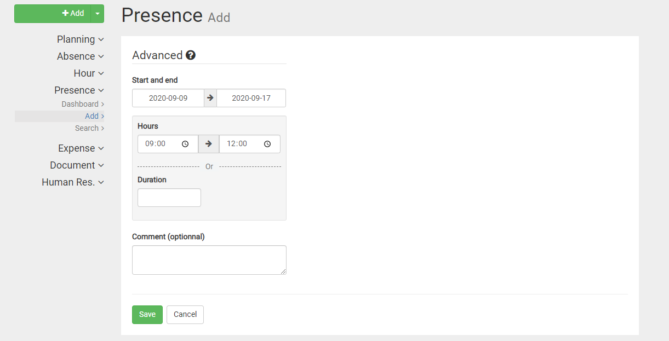
The third option!
Fill in the boxes.
Register.

Slide 19

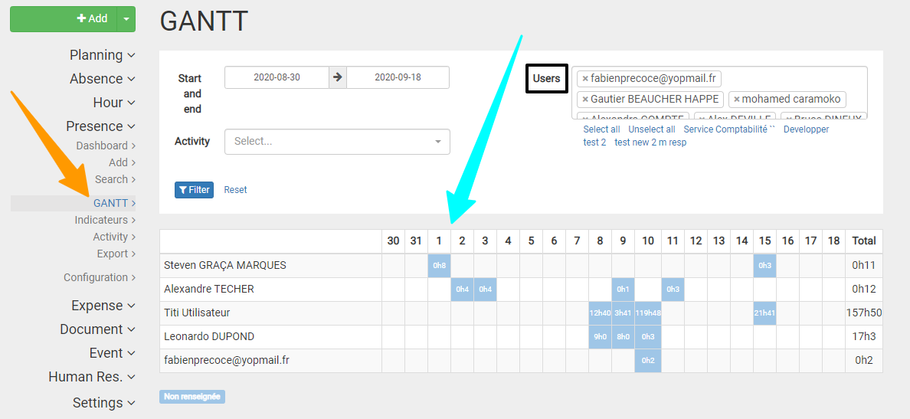
The GANTT
Go to the "GANTT" module
Remember to filter according to your needs.
The nature of the activity (if indicated by the user) is differentiated by color.
The table indicate you the number of hours worked per employee per day.

Slide 20


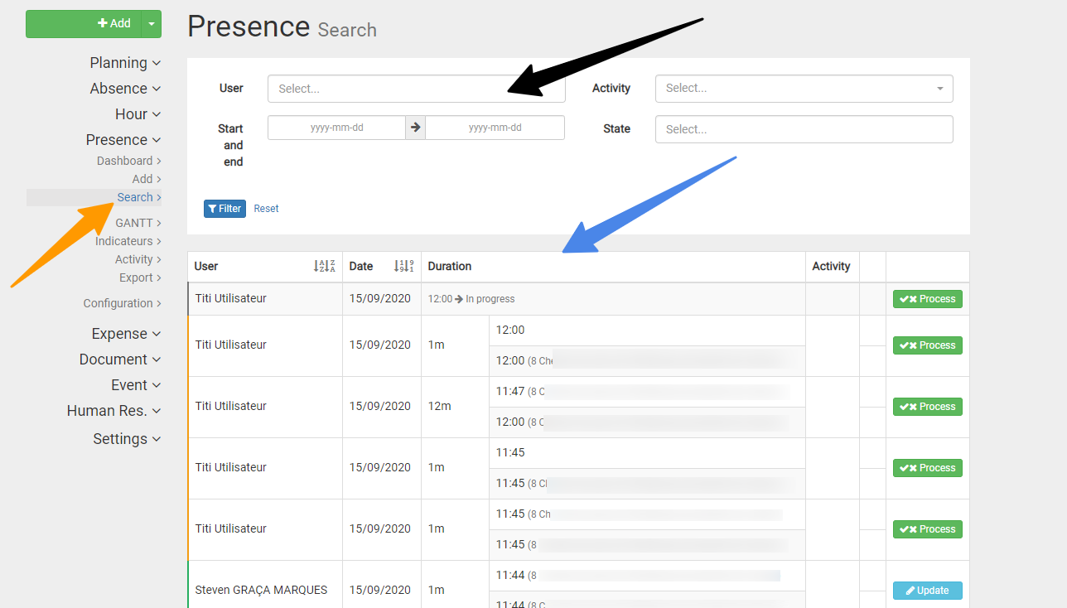
Search for the presence of a collaborator
Go to the "Search" tab.
Filter (if necessary) according to your needs.
The table shows you the data of the user in question (address, time etc...).

Slide 21


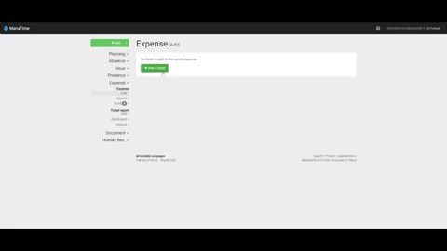

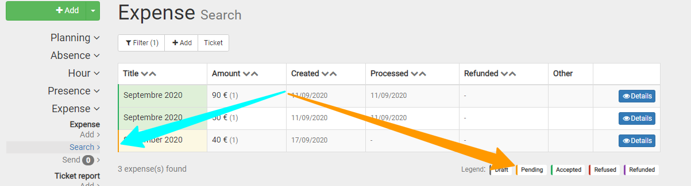
Expense reports
Add
Research
*You go directly to this page after the first step.
(GIF)

Slide 22

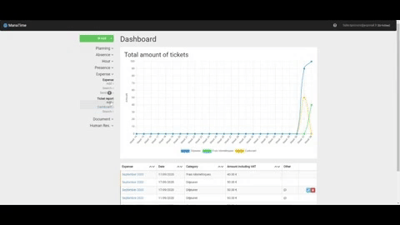
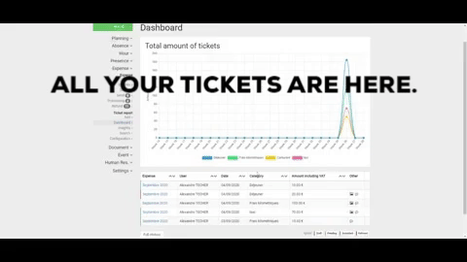
Ticket reports (GIF)

Slide 23

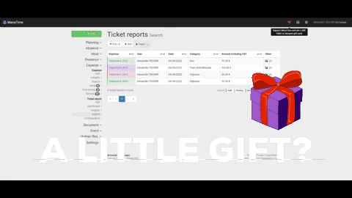
Sponsorship / Awards (GIF)

Slide 24

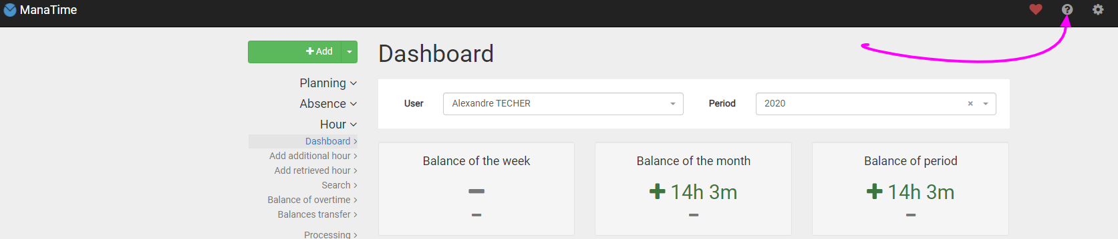
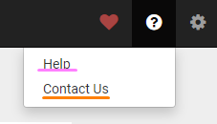
Online support
Click on the « ? »
Choose what you want

Slide 25

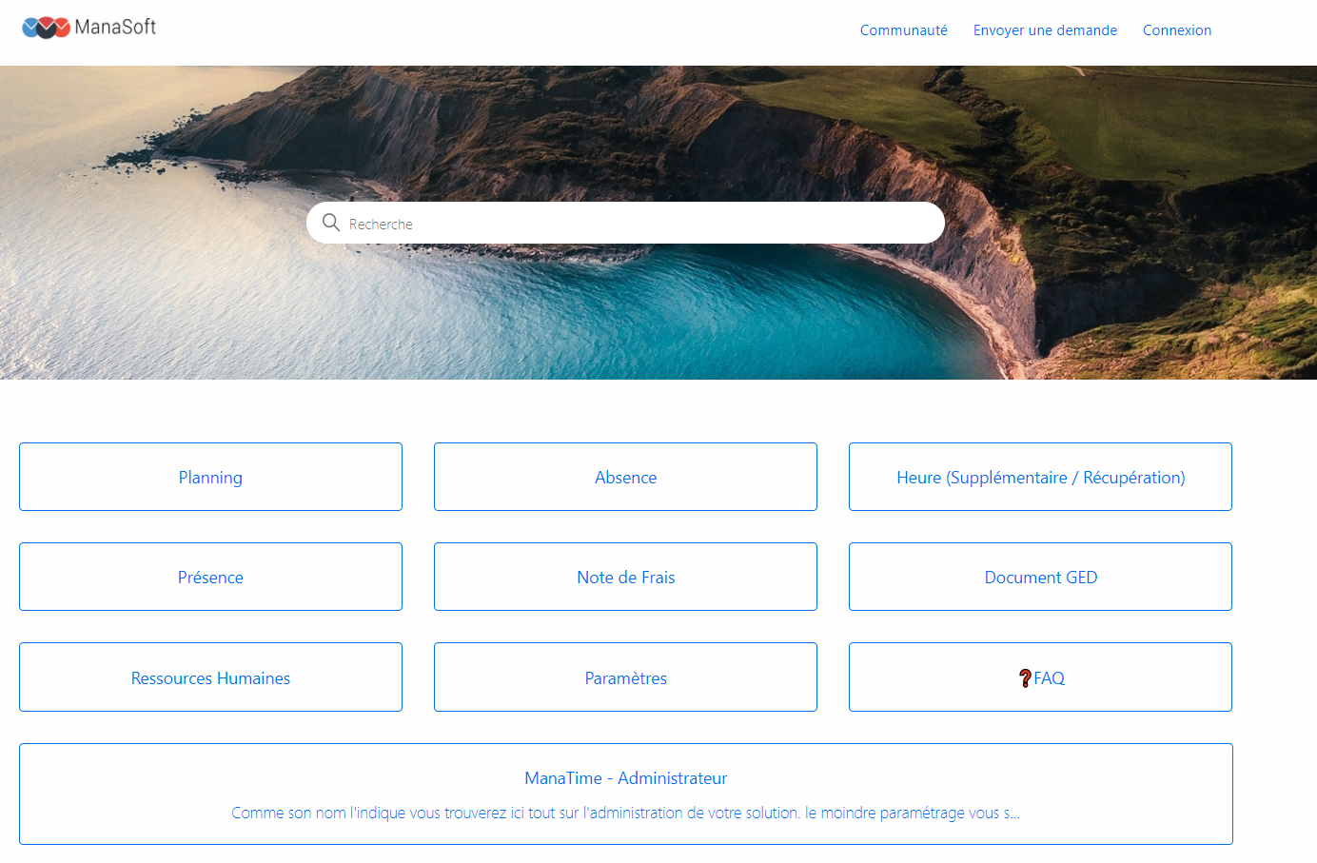
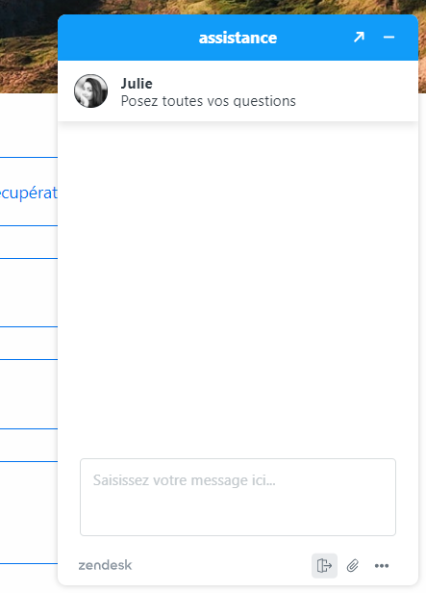
Help (FAQ and Online Chat)
The FAQ
The Online Chat

Slide 26

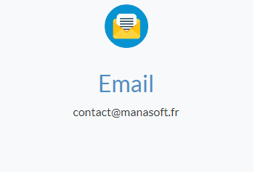
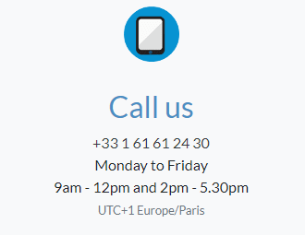
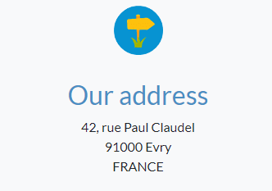
Contact Us

Slide 27


And that's it, it's already the end...

