Slide 1
Vacation pay software ManaTime
Starting well (User)

Slide 2
Recommended browsers
Google Chrome
Firefox
Safari

Slide 3
Disadvised browsers
Microsoft Edge
Opéra
Internet Explorer

Slide 4
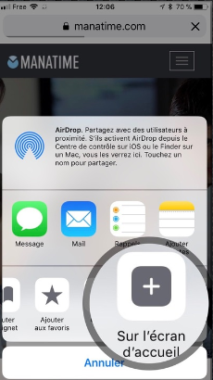
Install it on your iPhone / iPad

Slide 5
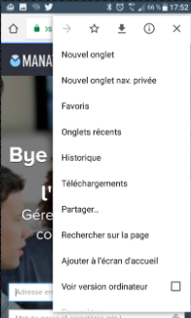
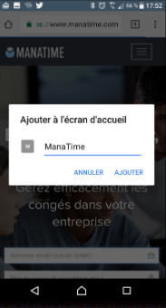
Install it on your Android / Tablet

Slide 6
Available on all devices !

Slide 7
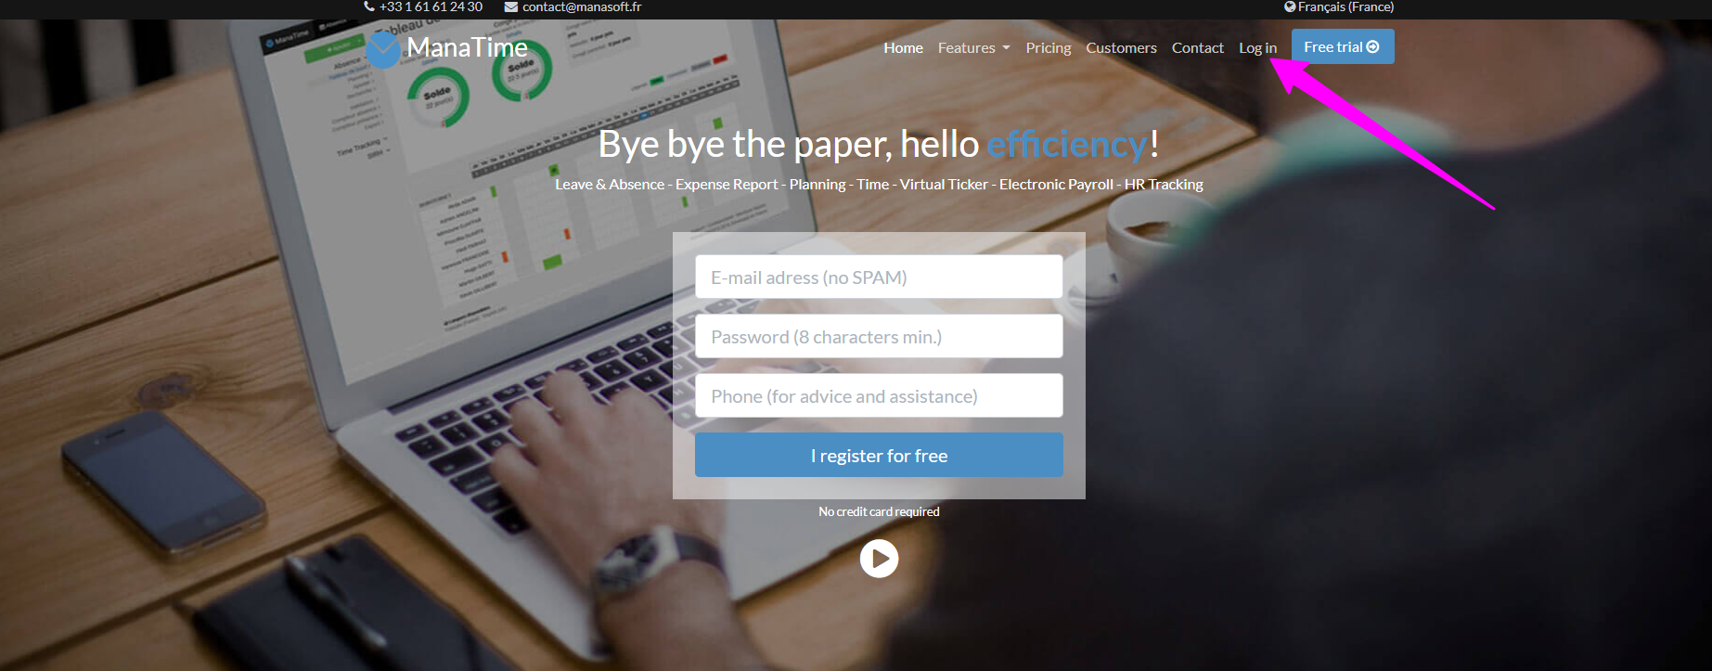
Login to our website http://www.manatime.com/

Slide 8
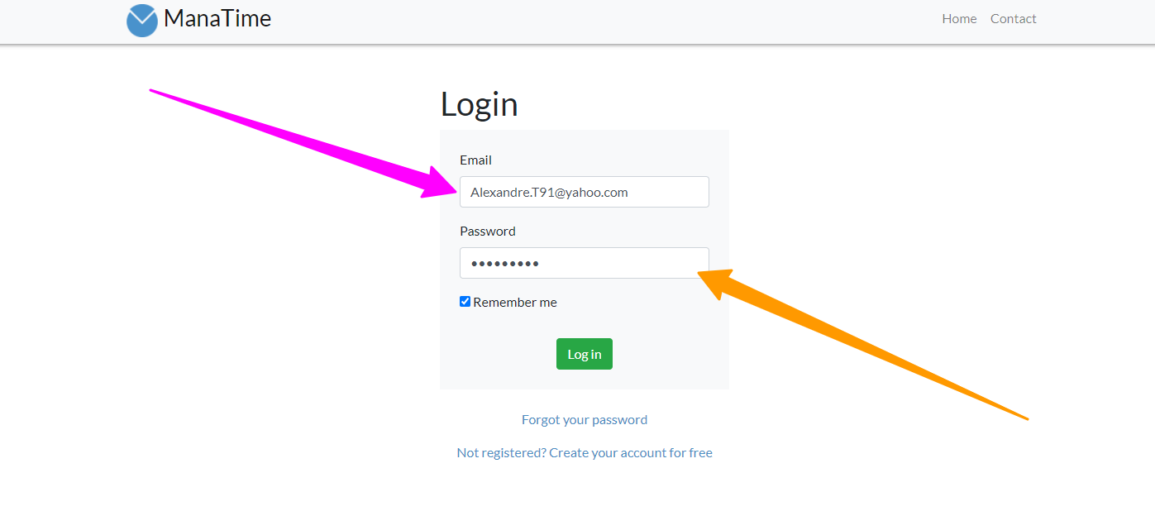
Enter your Ids

Slide 9
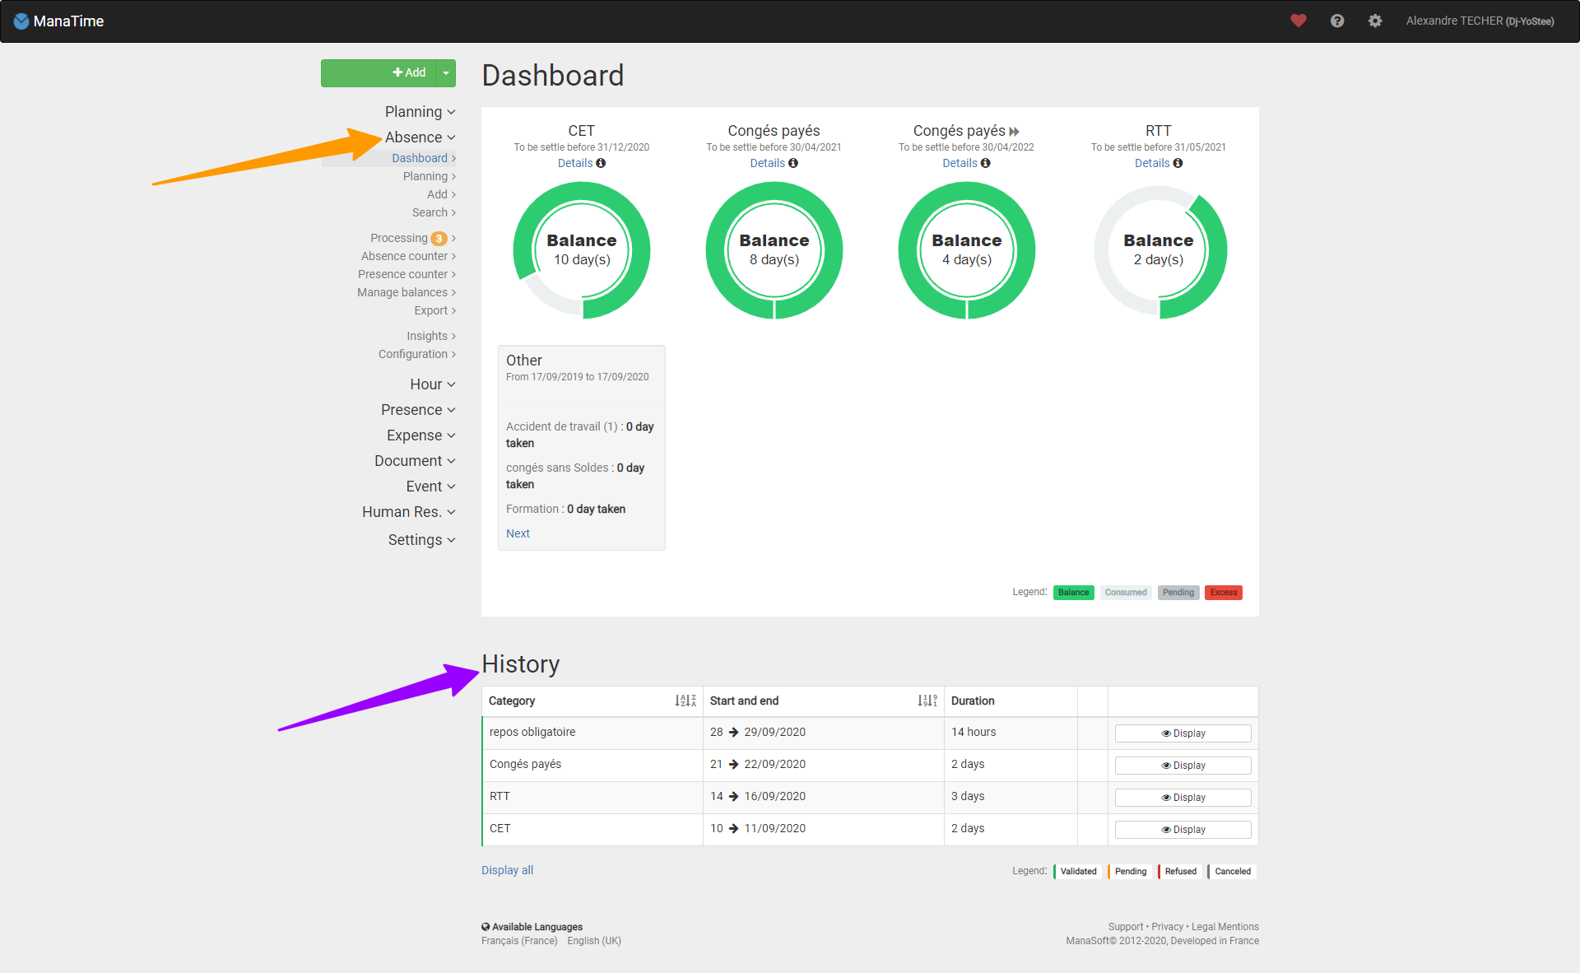
Check your balance
Click on the absence button
Then on the Dashboard
You also have a history just at the bottom of your page!

Slide 10
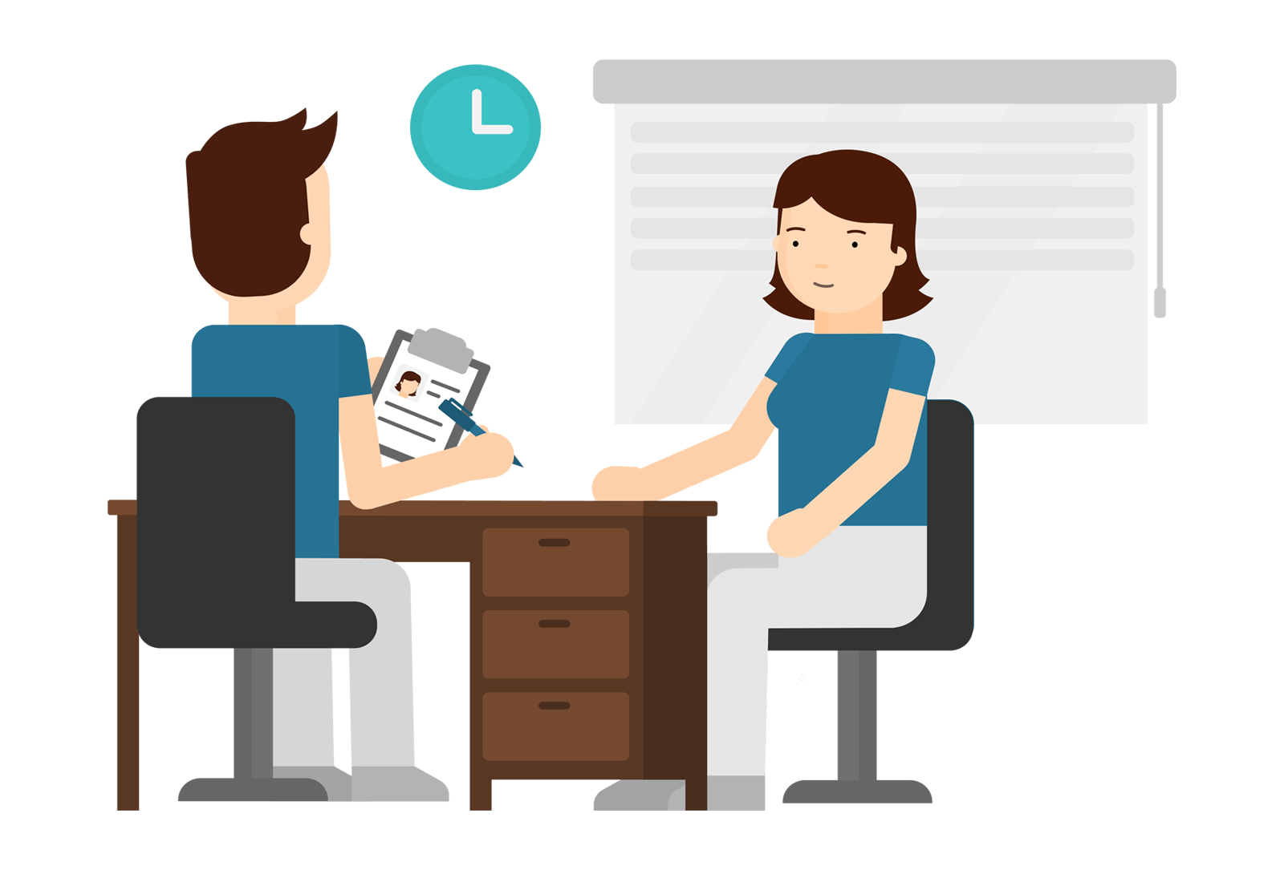
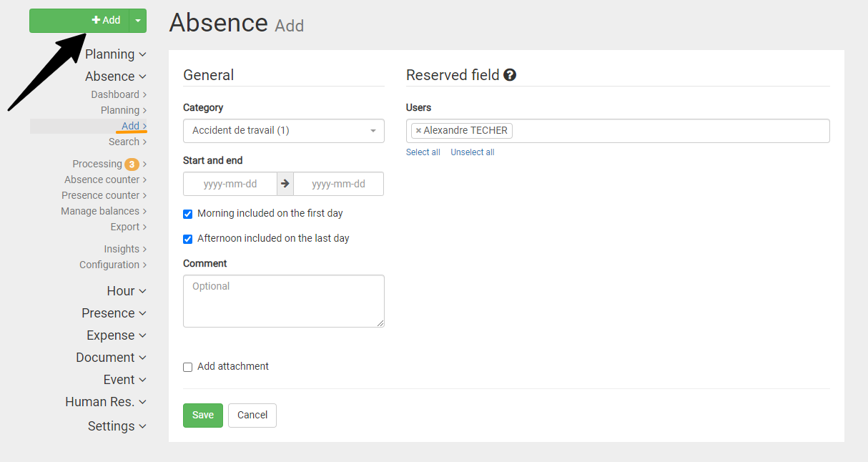
Apply for a leave of absence
Click on the button
Complete your demand now.
Once your request has been registered, it will automatically be sent to the person in charge of your department.

Slide 11
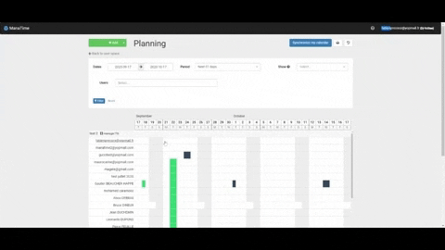
Another method in GIF !

Slide 12
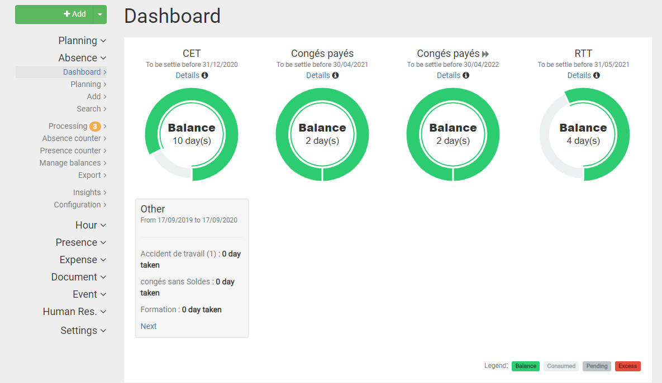
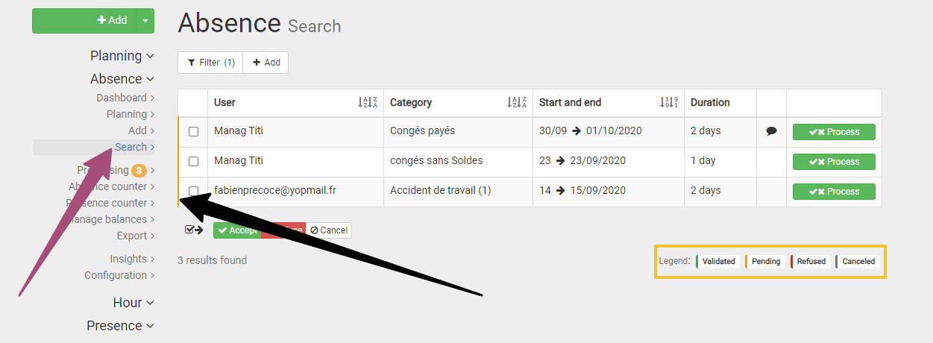
Your request is awaiting processing.
You can now see that your dashboard has moved.
You can also consult all your requests on the search page.

Slide 13
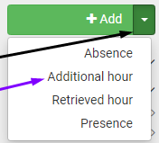
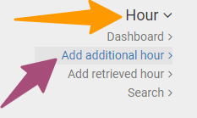
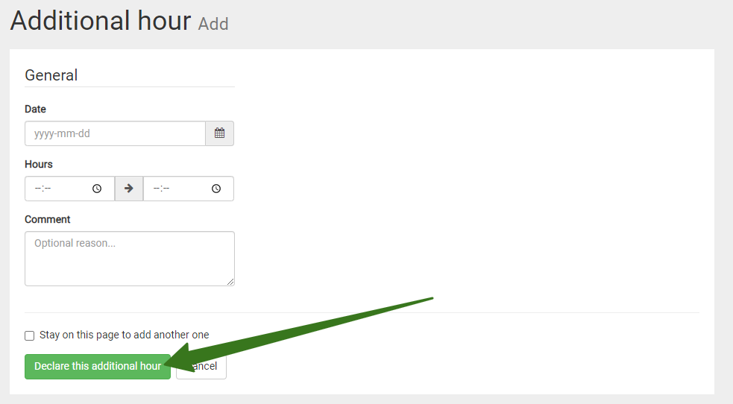
Deposit an extra hour / Recovery
Click on the arrow to the right of the "Add" button and choose overtime or recovery time.
You can also click Time / Add additional hour / Retrieved in your menu bar.
Then complete your form, register your request, it will be validated by your manager.

Slide 14
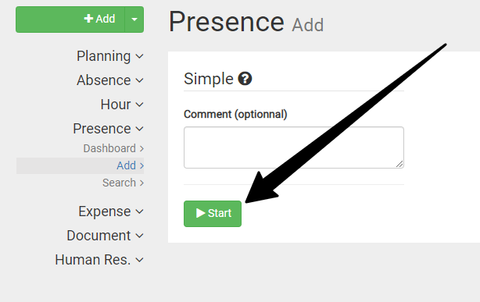
Start & Stop (Virtual Pointer)
Go to the tab "Presence" / "Add".
Comment (if necessary) and click Start.
Or click on the one on the top left.

Slide 15
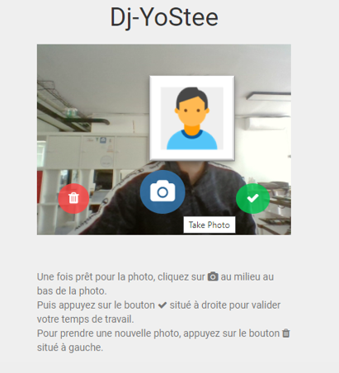
Face Tracking (1/2)
Place yourself in front of your photo space (sent link, tablet, PC, etc...)
Take a picture of yourself
Delete
Validate

Slide 16
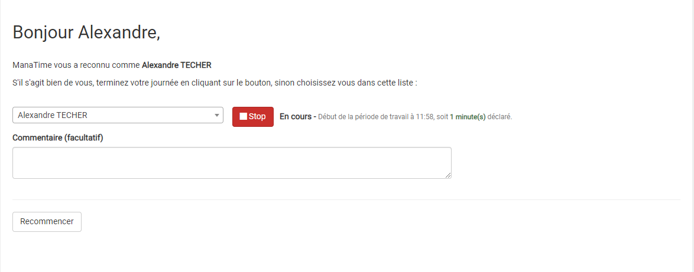
Continuation of the Process (2/2)
This is the end! Take a picture of yourself and
Click on

Slide 17
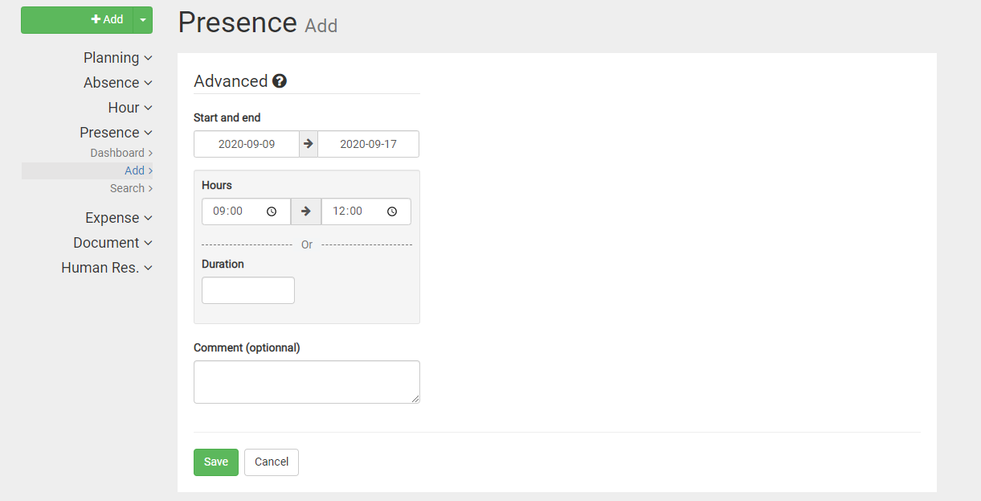
The third option!
Fill in the boxes.
Register

Slide 18
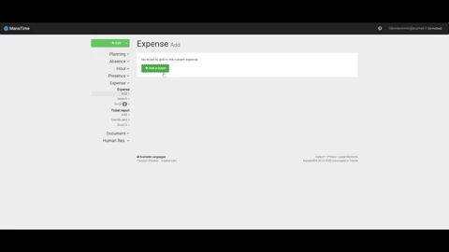
Expense reports
Add
Research
*You go directly to this page after the first step.
(GIF)

Slide 19
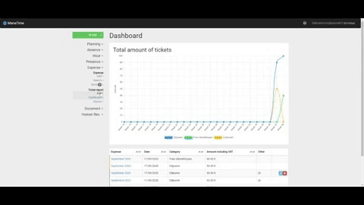
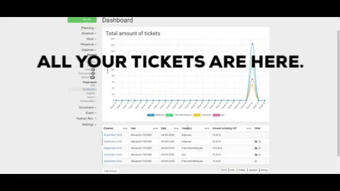
Ticket reports (GIF)

Slide 20
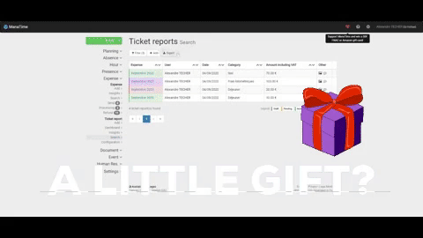
Sponsorship / Awards (GIF)

Slide 21
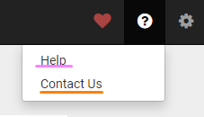
Online support
Click on the « ? »
Choose what you want

Slide 22
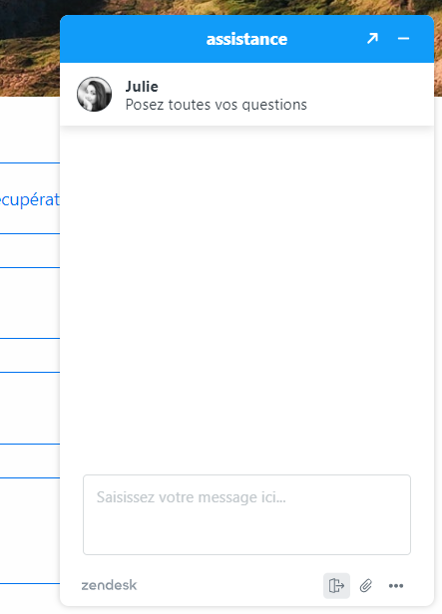
Help (FAQ and Online Chat)
The FAQ
The Online Chat

Slide 23
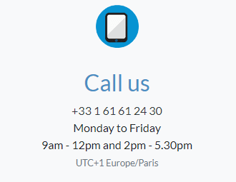
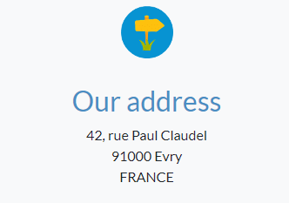
Contact Us

Slide 24
And that's it, it's already the end...

